Slide 1
VERBS!
Verbs Mean Action

Slide 2
Verbs are the words that will make your writing come alive! By choosing the right verbs you will be able to keep readers on the edge of their seats!

Slide 3
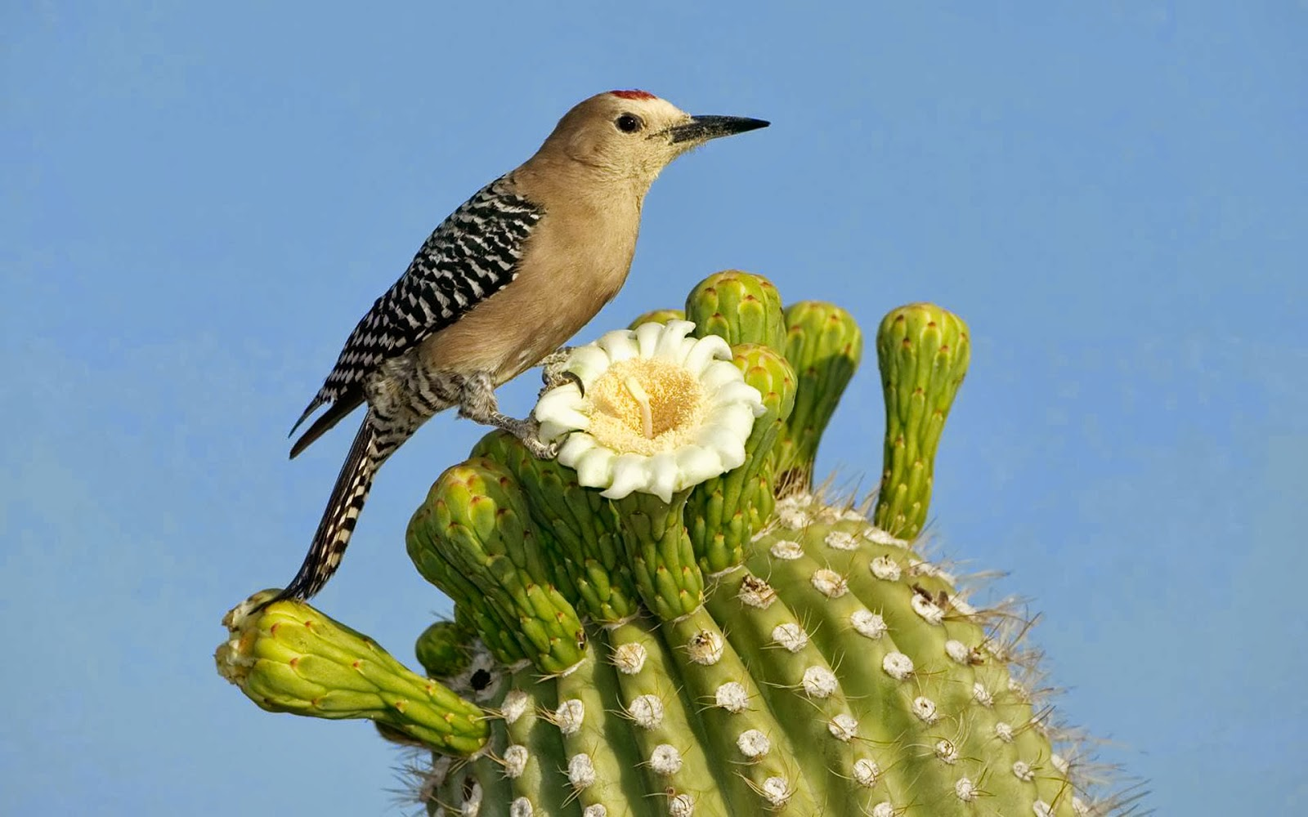
Some verbs show action. They tell exactly what the subject does.
Example
subject
Action verb
A cactus wren lives in the desert and builds its nest in a cactus.
Action verb

Slide 4
Sometimes an action verb is made up of two words: a main verb and a helping verb. The main verb describes the action; the helping verb usually comes before the main verb and does not show action.
Example
Cactus wrens will defend their nests from other animals.
Helping Verb
Action verb

Slide 5
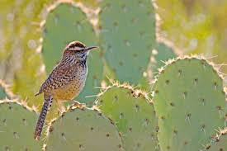
Now you try:
Find the ACTION VERBS?
This bird uses dry grass for the nest and lines the inside with feathers.
Find the helping and action verbs?
Sometimes these birds may destroy the nests of other birds.

Slide 6
Usually a helping verb comes right before its main verb, but not always.
A cactus wren can survive the desert because it does not need much water.
Are there any other verbs in this sentence?
Does “need” have a helping verb?
What word comes between does and need?
Why do you think it is not considered a verb?

Slide 7
Read the first sentence. What is the subject?
Linking verb
The cactus wren’s nest is a good home. It seems cozy and safe.
Is the nest doing anything in this sentence? Do any words show action?

Slide 8
Linking verbs do not show action. Instead, they link, or connect, the subject to words that tell what the subject is or is like- much the way an equals sign works in math.
The cactus wren’s nest is a good home. It seems cozy and safe.
What does the nest “equal” in each sentence?

Slide 9
Common linking verbs:
is
are
does
had
seem
did
has
have
become
do
must
can
could
may
might
shall
should
will
would

Slide 10
Guided Practice:
The desert kangaroo rat is an interesting animal. It hops on its big black legs. The rat’s legs are strong, and the rat can jump as far as nine feet. These powerful legs help the rat in other ways, too. If an unwelcome visitor is nearby, the kangaroo rat drums the ground with its feet. The sound may scare the other animal away. Also when the rat meets an enemy, such as a rattlesnake, the rat will kick sand in the animal’s face. If the rat is lucky, the snake will slither off. Otherwise, the rat becomes dinner!
L=
H =
A =

Slide 11
Get with a Partner:
Write a few sentences for your partner using at least two action verbs, two linking verbs, and one helping verb. Have your partner find all the verbs by circling the verb and putting the correct letter above it to show what kind of verb it is: L=Linking, H=Helping, A= Action
If you are having difficulty thinking of a topic to write about, why not try writing about being in a desert. Imagine how the desert feels, looks, and sounds and what the animals are doing.

